Slide 1
Selenium Automation Training By Riyaz Shaik

Slide 2
Introduction
Prerequisites for the training

Slide 3
What is Automation Testing?
Software testing technique that performs using special automated testing software tools to execute a test case suite
The automation testing software can also enter test data into the System Under Test, compare expected and actual results and generate detailed test reports.
Automated software testing's main benefit is that it simplifies as much of the manual effort as possible into a set of scripts.

Slide 4
Manual Testing Vs Automation Testing
Manual Testing | Automation Testing
Done manually by QA testers | Done automatically using automation tools and scripts
Time-consuming and less efficient | More testing in less time and greater efficiency
Entirely manual tasks | Most tasks can be automated, including real user simulations
Difficult to ensure sufficient test coverage | Easy to ensure greater test coverage
The biggest pro of automation testing over manual testing is that it allows you to do more testing in less time

Slide 5
Licensed Vs Open source tools
Open Source Tools | Licensed Tools
Open source software is a computer software whose source code is available openly in internet and programmers can use it without any cost. | Licensed Tools is a computer software where the source codes are not publicly not available only the company which has created can modify it.
In open source software the source code is public. | In proprietary software the source code is protected.
Open source software can be installed into any computer. | Proprietary software can be installed into any computer without valid license.
Managed by open source community | On Time / Quick Support
Ex: Selenium, Appium, Jmeter etc | Ex: Test Complete, UFT, Katalon Studio

Slide 6
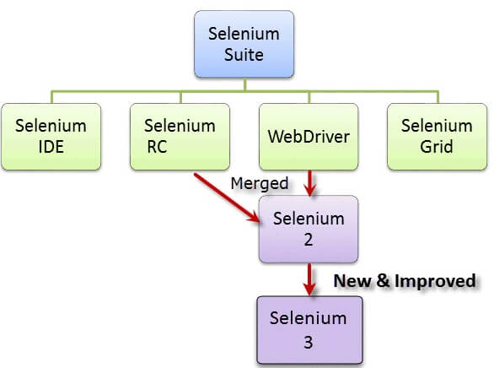
Overview Of Selenium
Selenium is a free (open-source) automated testing framework used to validate web applications across different browsers and platforms.
You can use multiple programming languages like Java, C#, Python etc to create Selenium Test Scripts.

Slide 7
Selenium Tools
Selenium IDE: Selenium Integrated Development Environment (IDE) is the simplest framework in the Selenium suite and is the easiest one to learn. It is a Firefox/Chrome plugin that you can install as easily as you can with other plugins.
Selenium RC: .This is the first automated web testing tool that allowed users to use a programming language they prefer. Slower execution time and needs selenium RC server to be running
Selenium Webdriver: The WebDriver proves itself to be better than both Selenium IDE and Selenium RC in many aspects. It implements a more modern and stable approach in automating the browser’s actions. It controls the browser by directly communicating with it.Faster Execution than IDE and RC
Selenium Grid: Selenium Grid is a tool used together with Selenium RC to run parallel tests across different machines and different browsers all at the same time. Parallel execution means running multiple tests at once.

Slide 8
Installing JAVA on Windows
Navigate to https://www.oracle.com/java/technologies/downloads/#jdk17-windows
Download x64 Installer https://download.oracle.com/java/17/latest/jdk-17_windows-x64_bin.exe
When you click on the Installation link the popup will be open. Click on I reviewed and accept the Oracle Technology Network License Agreement for Oracle Java SE development kit and you will be redirected to the login page. If you don’t have an oracle account you can easily sign up by adding basics details of yours.
Once the Java JDK download is complete, run the exe for install JDK. Click Next
Once you install Java in windows, click Close
Set Path and Classpath

Slide 9
Installing JAVA on Mac
To install the JDK on macOS:
Download the JDK .dmg file, jdk-10.interim.update.patch-macosx-x64.dmg.Before the file can be downloaded, you must accept the license agreement.
From either the browser Downloads window or from the file browser, double-click the .dmg file to start it.A Finder window appears that contains an icon of an open box and the name of the .pkg file.
Double-click the JDK 10.pkg icon to start the installation application.The installation application displays the Introduction window.
Click Continue.The Installation Type window appears.
Click Install.A window appears that displays the message: Installer is trying to install new software. Enter your password to allow this.
Enter the Administrator user name and password and click Install Software.The software is installed and a confirmation window is displayed.
After the software is installed, you can delete the .dmg file if you want to save disk space.

Slide 10
Set JavaHome in Mac
open ~/.bash_profile in any text editor and add:
export JAVA_HOME=$(/usr/libexec/java_home)
Save and close the file.
Open a Terminal and run the source command to apply the changes:
source ~/.bash_profileNow we can check the value of the JAVA_HOME variable:
echo $JAVA_HOMEThe result should be the path to the JDK installation:

Slide 11
Set Java Home on Windows
Open Search and type advanced system settings
In the shown options, select the View advanced system settings link
Under the Advanced tab, click Environment Variables
In the System variables section, click New (or User variables for single user setting)
Set JAVA_HOME as the Variable name and the path to the JDK installation as the Variable value and click OK
Set path also with the bin folder path> click path> click new> enter the jdk bin path
Click OK and click Apply to apply the changes

Slide 12
Lets look practically
Installation of Eclipse IDE
How to create new Java Project
How to create new Java Class
Compiling and Running java class
Analyzing the results of java program

Slide 13
Data Types
a data type is an attribute of data which tells the compiler or interpreter how the programmer intends to use the data. ... This data type defines the operations that can be done on the data, the meaning of the data, and the way values of that type can be stored.
Primitive data types: The primitive data types include boolean, char, byte, short, int, long, float and double.
Non-primitive data types: The non-primitive data types include Classes, Interfaces, and Arrays.

Slide 14
Data Types Default Size
Data Type | Default Value | Default size
boolean | false | 1 bit
char | '\u0000' | 2 byte
byte | 0 | 1 byte
short | 0 | 2 byte
int | 0 | 4 byte
long | 0L | 8 byte
float | 0.0f | 4 byte
double | 0.0d | 8 byte

Slide 15
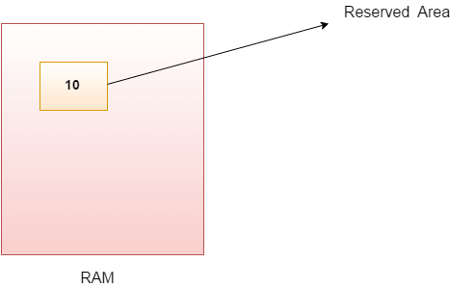
Java Variable
A variable is a container which holds the value while the Java program is executed. A variable is assigned with a data type.
Variable is a name of memory location. There are three types of variables in java: local, instance and static.

Slide 16
Practice Exercise
Declare a variable named value_int of the data type int that is assigned the value 20
Secondly, declare a variable named value_string of the data type string that is assigned the value “Java”
Third, create a variable named value_double of the data type double that is assigned the value 23.63
Finally, print all variables in the console.
To create a new variable in Java,
First specify the data type followed by the variable name
Then assign the value equal to the “=” operator
Don’t forget the semicolon at the end

Slide 17
Operators
Operator in Java is a symbol that is used to perform operations. For example: +, -, *, / etc.
Operator Type | Category | Precedence
Arithmetic | multiplicative | * / %
 | additive | + -
Relational | comparison | < > <= >= instanceof
 | equality | == !=
Bitwise | bitwise AND | &
 | bitwise exclusive OR | ^
 | bitwise inclusive OR | |
Logical | logical AND | &&
 | logical OR | ||
Assignment | assignment | = += -= *= /= %= &= ^= |= <<= >>= >>>=

Slide 18
Types Of Variables
1) Local Variable
A variable declared inside the body of the method is called local variable. You can use this variable only within that method and the other methods in the class aren't even aware that the variable exists.
A local variable cannot be defined with "static" keyword.
2) Instance Variable
A variable declared inside the class but outside the body of the method, is called an instance variable. It is not declared as static.
It is called an instance variable because its value is instance-specific and is not shared among instances.
3) Static variable
A variable that is declared as static is called a static variable. It cannot be local. You can create a single copy of the static variable and share it among all the instances of the class. Memory allocation for static variables happens only once when the class is loaded in the memory.

Slide 19
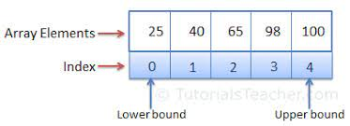
What is an array?
An array is a collection of similar items stored at contiguous memory locations. The idea is to store multiple items of the same type together.
Array in Java is index-based, the first element of the array is stored at the 0th index, 2nd element is stored on 1st index and so on.

Slide 20
Types of Arrays
There are two types of array.
Single Dimensional Array
Multidimensional Array
Syntax of Single Dimensional Array: dataType[] arr; (or)
dataType []arr; (or) dataType arr[];
Instantiation:
datatype arrayRefVar=new datatype[size];

Slide 21
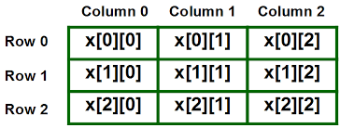
Multi Dimensional Array
Syntax to declare:
dataType[][] arrayRefVar;
Example:
int[][] arr=new int[3][3]

Slide 22
Conditional Statements – simple If condition
The Java if statement tests the condition. It executes the if block if condition is true.
Syntax:
if(condition)
{
//code to be executed
}

Slide 23
Java if-else Statement
The Java if-else statement also tests the condition. It executes the if block if condition is true otherwise else block is executed.
Syntax:
if(condition){
//code if condition is true
}
Else
{
//code if condition is false
}

Slide 24
Java if-else-if ladder Statement
The if-else-if ladder statement executes one condition from multiple statements.
Syntax:
if(condition1){
//code to be executed if condition1 is true
}else if(condition2){
//code to be executed if condition2 is true
}
else if(condition3){
//code to be executed if condition3 is true
}
...
else{
//code to be executed if all the conditions are false
}

Slide 25
Java Nested if statement
The nested if statement represents the if block within another if block. Here, the inner if block condition executes only when outer if block condition is true.
Syntax:
if(condition){
//code to be executed
if(condition){
//code to be executed
}
}

Slide 26
Switch Case Statement
The Java switch statement executes one statement from multiple conditions. It is like if-else-if ladder statement.
Each case statement can have a break statement which is optional. When control reaches to the break statement, it jumps the control after the switch expression. If a break statement is not found, it executes the next case.

Slide 27
Switch Case Syntax
Syntax:
switch(expression){
case value1:
//code to be executed;
break; //optional
case value2:
//code to be executed;
break; //optional
......
default:
code to be executed if all cases are not matched;
}

Slide 28
Loop Statements - While
The Java while loop is used to iterate a part of the program repeatedly until the specified Boolean condition is true. As soon as the Boolean condition becomes false, the loop automatically stops.
The while loop is considered as a repeating if statement. If the number of iteration is not fixed, it is recommended to use the while loop.
Syntax:
while (condition){
//code to be executed
Increment / decrement statement
}

Slide 29
Java do-while Loop
The Java do-while loop is used to iterate a part of the program repeatedly, until the specified condition is true. If the number of iteration is not fixed and you must have to execute the loop at least once, it is recommended to use a do-while loop.
Syntax:
do{
//code to be executed / loop body
//update statement
}while (condition);

Slide 30
For Loop In Java
The Java for loop is used to iterate a part of the program several times. If the number of iteration is fixed
for(initialization; condition; increment/decrement){
//statement or code to be executed
}
it is recommended to use for loop.

Slide 31
Java Nested for Loop
If we have a for loop inside the another loop, it is known as nested for loop. The inner loop executes completely whenever outer loop executes.
Syntax:
for(int i=1;i<=3;i++){
//loop of j
for(int j=1;j<=3;j++){
System.out.println(i+" "+j);
}//end of i
}//end of j
}

Slide 32
Java Break Statement
When a break statement is encountered inside a loop, the loop is immediately terminated and the program control resumes at the next statement following the loop.

Slide 33
Classes and Objects
An object is an instance of a class. A class is a template or blueprint from which objects are created. So, an object is the instance(result) of a class.
Syntax to create an object:
ClassName object = new ClassName();

Slide 34
Constructors in Java
In Java, a constructor is a block of codes similar to the method. It is called when an instance of the class is created. At the time of calling constructor, memory for the object is allocated in the memory.
It is a special type of method which is used to initialize the object.
Every time an object is created using the new() keyword, at least one constructor is called.
It calls a default constructor if there is no constructor available in the class. In such case, Java compiler provides a default constructor by default.

Slide 35
Types Of Constructors
There are two types of constructors in Java: no-arg constructor, and parameterized constructor.
Note: It is called constructor because it constructs the values at the time of object creation. It is not necessary to write a constructor for a class. It is because java compiler creates a default constructor if your class doesn't have any.
Syntax:
<class_name>(){}

Slide 36
Rules for Creating Constructor
Rules for creating Java constructor
There are two rules defined for the constructor.
Constructor name must be the same as its class name
A Constructor must have no explicit return type
A Java constructor cannot be abstract, static, final, and synchronized

Slide 37
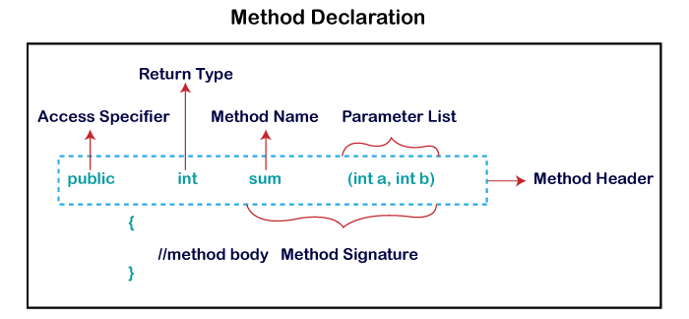
Working with methods
In general, a method is a way to perform some task. Similarly, the method in Java is a collection of instructions that performs a specific task. It provides the reusability of code. We can also easily modify code using methods.

Slide 38
Types Of Methods
Parameterised Methods
Non Parameterised Methods
Static Methods
Instance Methods

Slide 39
Programming Exercises – Prog1
Create a class “MathsCalc”
Create two global variables with values 235 and 355
Create a static method that sums up above two values
and store the result in another variable. Also display the result of sum
Create a non static method that multiplies the above result three times
And display the result

Slide 40
Programming Exercise – Prog2
Create a class “Table”
Create a method that accepts any integer
In the method write the logic to print maths table for any given number
Print the table till 10th iteration
Ex: 3*1 = 3
3*2 = 6
3*3 = 9
……………………….till 3*10 = 30

Slide 41
Programming Exercise – Prog 3
Create a class “MaxArray”
Take even number array upto 10 numbers
Print the max value of the array
Print the min value of the array

Slide 42
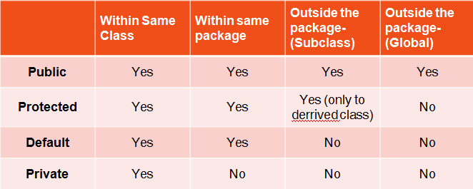
Access modifiers
The access modifiers in java Specifies the accessibility or scope of field, method, constructor or class.

Slide 43
String Class in Java
In Java, string is basically an object that represents sequence of char values. An array of characters works same as Java string. For example:
char[] ch={'j','a','v','a','t','p','o','i','n','t'};
String s=new String(ch);
is same as:
String s="javatpoint";

Slide 44
String in Java
In Java, string is an object that represents a sequence of characters. The java.lang.String class is used to create a string object.
How to create a string object?
There are two ways to create String object:
By string literal
By new keyword

Slide 45
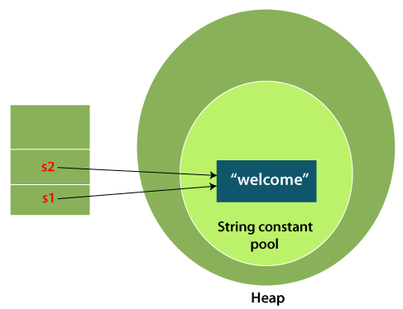
Using String literal
String s1="Welcome";
String s2="Welcome";//It doesn't create a new instance

Slide 46
By new keyword
String s=new String("Welcome");//creates two objects and one reference variable
In such case, JVM will create a new string object in normal (non-pool) heap memory, and the literal "Welcome" will be placed in the string constant pool. The variable s will refer to the object in a heap (non-pool).

Slide 47
Programming Exercise – Prog4
Create a string “Selenium Webdriver ” using string literal
Get the text “Webdriver” only from the above string and store in another string
Print only “driver” from the above string and store it in another string
Convert the “driver” to chararray and store it in char array
Iterate the above char array and print the characters

Slide 48
Oops
Object-Oriented Programming is a methodology or paradigm to design a program using classes and objects. It simplifies software development and maintenance by providing some concepts:
Object
Class
Inheritance
Polymorphism
Abstraction
Encapsulation
inferface

Slide 49
Inheritance
Inheritance in Java is a mechanism in which one object acquires all the properties and behaviors of a parent object. It is an important part of OOPs (Object Oriented programming system).
Syntax:
class Subclass-name extends Superclass-name
{
//methods and fields
}

Slide 50
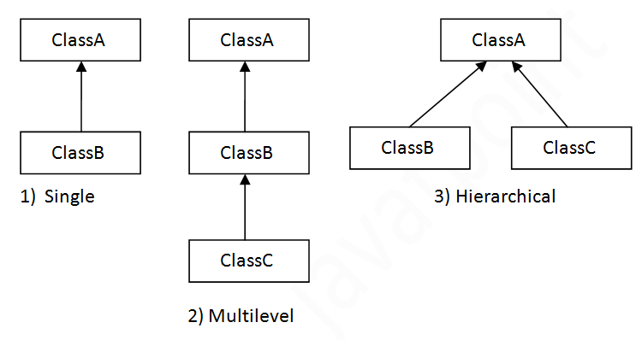
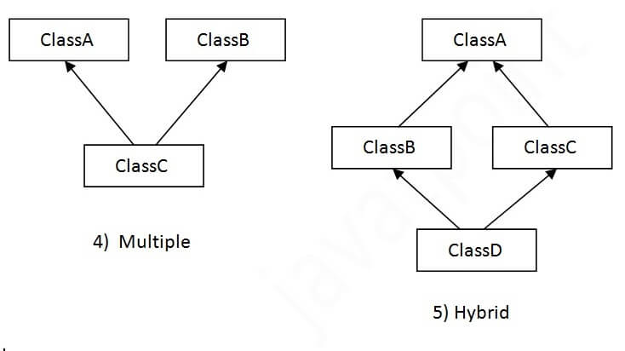
Types of inheritance in java

Slide 51
Terms used in Inheritance
Class: A class is a group of objects which have common properties. It is a template or blueprint from which objects are created.
Sub Class/Child Class: Subclass is a class which inherits the other class. It is also called a derived class, extended class, or child class.
Super Class/Parent Class: Superclass is the class from where a subclass inherits the features. It is also called a base class or a parent class.
Reusability: As the name specifies, reusability is a mechanism which facilitates you to reuse the fields and methods of the existing class when you create a new class. You can use the same fields and methods already defined in the previous class.

Slide 52
Abstraction in Java
Abstraction is a process of hiding the implementation details and showing only functionality to the user.
Another way, it shows only essential things to the user and hides the internal details, for example, sending SMS where you type the text and send the message. You don't know the internal processing about the message delivery.
There are two ways to achieve abstraction in java
Abstract class (0 to 100%)
Interface (100%)

Slide 53
Abstract class in Java
A class which is declared as abstract is known as an abstract class. It can have abstract and non-abstract methods. It needs to be extended and its method implemented. It cannot be instantiated.
Points to Remember
An abstract class must be declared with an abstract keyword.
It can have abstract and non-abstract methods.
It cannot be instantiated.
It can have constructors and static methods also.
It can have final methods which will force the subclass not to change the body of the method.

Slide 54
Abstract Method in Java
A method which is declared as abstract and does not have implementation is known as an abstract method.
Example of abstract method
abstract void printStatus();//no method body and abstract

Slide 55
Interface in Java
An interface in Java is a blueprint of a class. It has static constants and abstract methods.
The interface in Java is a mechanism to achieve abstraction. There can be only abstract methods in the Java interface, not method body till java 8. It is used to achieve abstraction and multiple inheritance in Java.

Slide 56
How to declare an interface?
An interface is declared by using the interface keyword. It provides total abstraction; means all the methods in an interface are declared with the empty body, and all the fields are public, static and final by default.
A class that implements an interface must implement all the methods declared in the interface.
interface <interface_name>{
// declare constant fields
// declare methods that abstract
// by default.
}

Slide 57
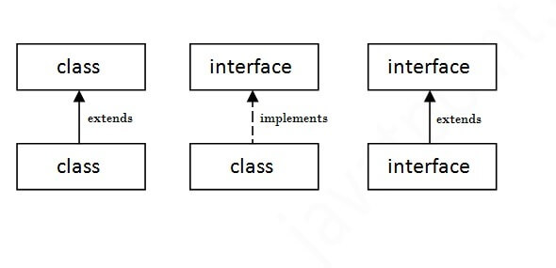
Java 8 Interface Improvement
Since Java 8, interface can have default and static methods
As shown in the figure given below, a class extends another class, an interface extends another interface, but a class implements an interface.

Slide 58
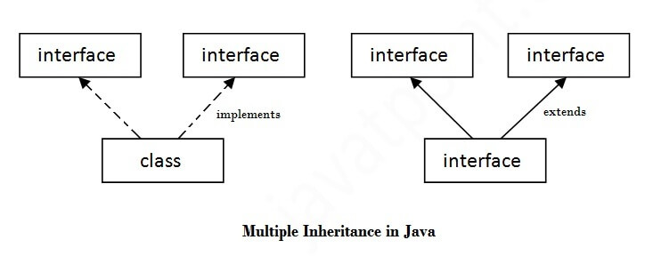
Multiple inheritance in Java by interface
If a class implements multiple interfaces, or an interface extends multiple interfaces, it is known as multiple inheritance

Slide 59
Encapsulation
Encapsulation is one of the four fundamental OOP concepts. The other three are inheritance, polymorphism, and abstraction.
Encapsulation in Java is a mechanism of wrapping the data (variables) and code acting on the data (methods) together as a single unit. In encapsulation, the variables of a class will be hidden from other classes, and can be accessed only through the methods of their current class. Therefore, it is also known as data hiding.

Slide 60
To achieve encapsulation in Java
Declare the variables of a class as private.
Provide public setter and getter methods to modify and view the variables values
Benefits of Encapsulation
The fields of a class can be made read-only or write-only.
A class can have total control over what is stored in its fields.

Slide 61
Exception Handling in JAVA
In Java, an exception is an event that disrupts the normal flow of the program. It is an object which is thrown at runtime.
The core advantage of exception handling is to maintain the normal flow of the application. An exception normally disrupts the normal flow of the application; that is why we need to handle exceptions

Slide 62
Types of Java Exceptions
There are mainly two types of exceptions: checked and unchecked.
Checked Exception
Unchecked Exception
1) Checked Exception---Complie Time
The classes that directly inherit the Throwable class except RuntimeException and Error are known as checked exceptions. For example, IOException, SQLException, etc. Checked exceptions are checked at compile-time.
2) Unchecked Exception-Run Time
The classes that inherit the RuntimeException are known as unchecked exceptions. For example, ArithmeticException, NullPointerException, ArrayIndexOutOfBoundsException, etc. Unchecked exceptions are not checked at compile-time, but they are checked at runtime.

Slide 63
Java Exception Keywords
Keyword | Description
try | The "try" keyword is used to specify a block where we should place an exception code. It means we can't use try block alone. The try block must be followed by either catch or finally.
catch | The "catch" block is used to handle the exception. It must be preceded by try block which means we can't use catch block alone. It can be followed by finally block later.
finally | The "finally" block is used to execute the necessary code of the program. It is executed whether an exception is handled or not.

Slide 64
Java Exception Keywords
Keyword | Description
throw | The "throw" keyword is used to throw an exception.
throws | The "throws" keyword is used to declare exceptions. It specifies that there may occur an exception in the method. It doesn't throw an exception. It is always used with method signature.

Slide 65
Wrapper Classes
Primitive Type | Wrapper Class
boolean | Boolean
char | Character
byte | Byte
short | Short
int | Integer
long | Long
float | Float
double | Double

Slide 66
Common Scenarios of Java Exceptions
1) A scenario where ArithmeticException occurs
If we divide any number by zero, there occurs an ArithmeticException.
int a=50/0;//ArithmeticException
2) A scenario where NullPointerException occurs
If we have a null value in any variable, performing any operation on the variable throws a NullPointerException.
String s=null;
System.out.println(s.length());//NullPointerException

Slide 67
Contd..
3) A scenario where NumberFormatException occurs
If the formatting of any variable or number is mismatched, it may result into NumberFormatException. Suppose we have a string variable that has characters; converting this variable into digit will cause NumberFormatException.
String s="abc";
int i=Integer.parseInt(s);//NumberFormatException

Slide 68
Contd..
4) A scenario where ArrayIndexOutOfBoundsException occurs
When an array exceeds to it's size, the ArrayIndexOutOfBoundsException occurs. there may be other reasons to occur ArrayIndexOutOfBoundsException. Consider the following statements.
int a[]=new int[5];
a[10]=50; //ArrayIndexOutOfBoundsException

Slide 69
Programming Exercise – Prog 5
Create a string “This is webdriver session”
Split the above string and store the values in String array
Take the last value from the above array and store it in another string and reverse the string
For the above reversed text attach “beginners” text to it and print the final result

Slide 70
Programming Exercise – Prog 6
String s = “Training”
Display the characters which are repeating
Hint: Convert the above string to char Array
Use for loop for the char array

Slide 71
Programming Exercise – Prog7
Create a Class “Base” and create a non static method “LaunchBrowser”
Create one more class “HomePage” and inherit with “Base” and override “LaunchBrowser” method in child class and change the logic
Create one more class “TestCase1” and inherit “HomePage” and create a new method “Login”
Try to call “LaunchBrowser” method first and then call “Login” method and print the result

Slide 72
Programming Exercise – Prog8
Create an abstract class “Institute”
Create a non abstract method “PrintStudentIds”
Overload the above method with atleast two parameters
Now create one abstract method “PrintStudentResults”
Using abstraction concept implement the above method and display the output as “Student results are different for every class”

Slide 73
Collections
The Collection in Java is a framework that provides an architecture to store and manipulate the group of objects.
What is Collection framework?
The Collection framework represents a unified architecture for storing and manipulating and sorting a group of objects. It has:
Interfaces and its implementations, i.e., classes

Slide 74
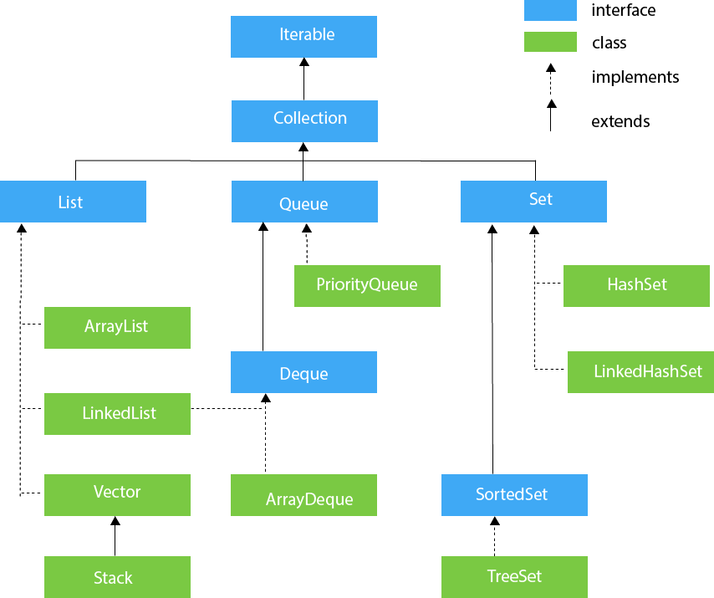
Collection Framework

Slide 75
Methods of Collection Interface
Method | Description
public boolean add(E e) | It is used to insert an element in this collection.
public boolean addAll(Collection<? extends E> c) | It is used to insert the specified collection elements in the invoking collection.
public boolean remove(Object element) | It is used to delete an element from the collection.
public boolean removeAll(Collection<?> c) | It is used to delete all the elements of the specified collection from the invoking collection.
public int size() | It returns the total number of elements in the collection.
public void clear() | It removes the total number of elements from the collection.

Slide 76
Collection Interface
The Collection interface is the interface which is implemented by all the classes in the collection framework. It declares the methods that every collection will have. In other words, we can say that the Collection interface builds the foundation on which the collection framework depends.
Some of the methods of Collection interface are Boolean add ( Object obj), Boolean addAll ( Collection c), void clear(), etc. which are implemented by all the subclasses of Collection interface.

Slide 77
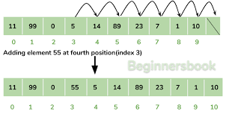
ArrayList
The ArrayList class implements the List interface. It uses a dynamic array to store the duplicate element of different data types. The ArrayList class maintains the insertion order and the elements stored in the ArrayList class can be randomly accessed

Slide 78
List Interface
List interface is the child interface of Collection interface. It inhibits a list type data structure in which we can store the ordered collection of objects. It can have duplicate values.
List interface is implemented by the classes ArrayList, LinkedList, Vector, and Stack.
To instantiate the List interface, we must use :
List <data-type> list1= new ArrayList();
List <data-type> list2 = new LinkedList();
There are various methods in List interface that can be used to insert, delete, and access the elements from the list.

Slide 79
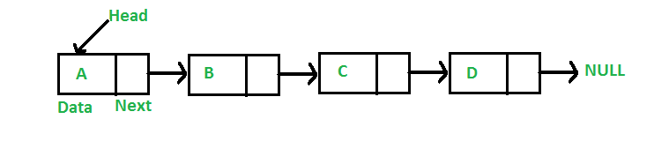
LinkedList
LinkedList implements the Collection interface. It uses a doubly linked list internally to store the elements. It can store the duplicate elements. It maintains the insertion order
In LinkedList, the manipulation is fast because no shifting is required.

Slide 80
Set Interface
Set Interface in Java is present in java.util package. It extends the Collection interface. It represents the unordered set of elements which doesn't allow us to store the duplicate items
Set is implemented by HashSet, LinkedHashSet, and TreeSet.
Set can be instantiated as:
Set<data-type> s1 = new HashSet<data-type>();
Set<data-type> s2 = new LinkedHashSet<data-type>();
Set<data-type> s3 = new TreeSet<data-type>();

Slide 81
HashSet
HashSet class implements Set Interface. Java HashSet class is used to create a collection that uses a hash table for storage.
HashSet contains unique elements only.
HashSet allows null value.
HashSet doesn't maintain the insertion order. Here, elements are inserted on the basis of their hashcode.
HashSet is the best approach for search operations.

Slide 82
Linked HashSet
Java LinkedHashSet class is a Hashtable and Linked list implementation of the set interface. It inherits HashSet class and implements Set interface.
The important points about Java LinkedHashSet class are:
Java LinkedHashSet class contains unique elements only like HashSet.
Java LinkedHashSet class provides all optional set operation and permits null elements.
Java LinkedHashSet class maintains insertion order.

Slide 83
Treeset
Java TreeSet class implements the Set interface that uses a tree for storage.
The important points about Java TreeSet class are:
Java TreeSet class contains unique elements only like HashSet.
Java TreeSet class access and retrieval times are quiet fast.
Java TreeSet class doesn't allow null element.
Java TreeSet class maintains ascending order.

Slide 84
Map
A map contains values on the basis of key, i.e. key and value pair. Each key and value pair is known as an entry. A Map contains unique keys.

Slide 85
Map
A Map doesn't allow duplicate keys, but you can have duplicate values. HashMap and LinkedHashMap allow null keys and values, but TreeMap doesn't allow any null key .
A Map can't be traversed, so you need to convert it into Set using keySet() or entrySet() method.
Class | Description
HashMap | HashMap is the implementation of Map, but it doesn't maintain any order.
LinkedHashMap | LinkedHashMap is the implementation of Map. It inherits HashMap class. It maintains insertion order.
TreeMap | TreeMap is the implementation of Map and SortedMap. It maintains ascending order.

Slide 86
Map.Entry Interface
Entry is the subinterface of Map. So we will be accessed it by Map.Entry name.
It returns a collection-view of the map, whose elements are of this class. It provides methods to get key and value.

Slide 87
Iterator Interface
Iterator and ListIterator are two interfaces in Java collection framework which are used to traverse the collections.
Using Iterator, you can traverse List, Set and Queue type of objects. But using ListIterator, you can traverse only List objects.
Using Iterator, we can traverse the elements only in forward direction. But, using ListIterator you can traverse the elements in both the directions – forward and backward.

Slide 88
Programming Exercise – Prog9
Create a list names
Add values to the list Amit, Vijay, Kumar, Sachin
Add Ajay at 4th index
Add Sachin again to the above list
Remove Vijay from the above list and replace with Mahesh
Add Sachin again to the above list
Iterate the above list and print portion of every name from 2nd index
Remove Duplicates from above list finally and print the final result

Slide 89
Programming Exercise – Prog 10
Create a set
Add values to set with Bangalore, Hyderabad, Mumbai, Delhi
Pick 2nd indexed value from the above set
Reverse the value
Now add the reversed value to the above set
Iterate the above set and print only Mumbai from the above set (don’t print all the values)

Slide 90
Selenium WebDriver
Selenium WebDriver is a web framework that permits you to execute cross-browser tests.
This tool is used for automating web-based application testing to verify that it performs expectedly.
Selenium WebDriver allows you to choose a programming language to create test scripts.

Slide 91
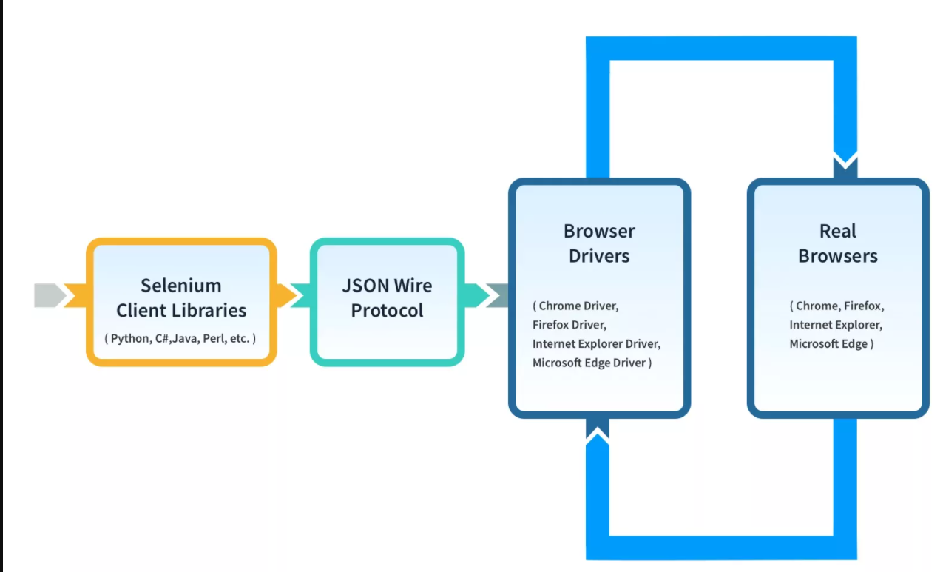
Architecture

Slide 92
Features Of Selenium WebDriver
It is one of the most popular Open-Source tools and is easy to get started with for testing web-based applications. It also allows you to perform cross browser compatibility testing.
Supports multiple operating systems like Windows, Mac, Linux, Unix, etc.
It provides compatibility with a range of languages including Python, Java, Perl, Ruby, etc.
Provides support for modern browsers like Chrome, Firefox, Opera, Safari, and Internet Explorer.
Selenium WebDriver completes the execution of test scripts faster when compared to other tools

Slide 93
Limitations of Selenium Webdriver
Selenium cannot extend support to the Windows applications, it only works on the web based applications.
Selenium is not capable of performing mobile automation on its own.
Selenium does not have any inbuilt reporting feature.
Selenium does not automate captcha.
Selenium does not automate barcodes.
Selenium depends on third party frameworks like TestNG, Cucumber for the reporting.
Selenium is open source, so in case of issues there is no prompt vendor assistance.
Selenium users need to be aware of some programming languages.

Slide 94
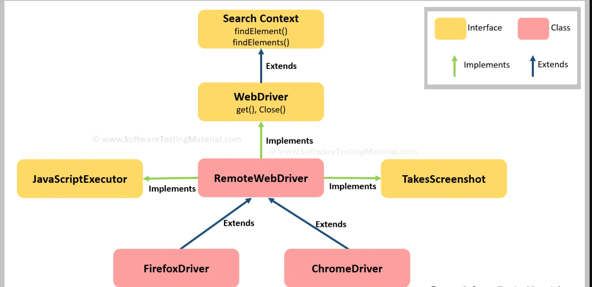
WebDriver Interface

Slide 95
Contd..
SearchContext is the super most interface in selenium, which is extended by another interface called WebDriver.
All the abstract methods of SearchContext and WebDriver interfaces are implemented in RemoteWebDriver class.
All the browser related classes such as FirefoxDriver, ChromeDriver etc., extends the RemoteWebdriver class.
WebDriver defines common methods which all browser classes (such as Firefox, Chrome etc.,) use. All these class methods are derived from WebDriver interface.
All the abstract methods of both the interfaces are implemented in RemoteWebDriver class which is extended by browser classes such as Firefox Driver, Chrome Driver etc.

Slide 96
Instance of WebDriver
WebDriver driver = new WebDriver();
We cannot write our code like this because we cannot create Object of an Interface. WebDriver is an interface.
But we can use any of the following statements in our script
FirefoxDriver driver = new FirefoxDriver();
or
WebDriver driver = new FirefoxDriver();

Slide 97
Lets learn Practically
Configure Selenium Webdriver with Eclipse IDE
Configure Selenium with Chromedriver, FirefoxDriver,Internet ExplorerDriver, EdgeDriver

Slide 98
Get Method
Get Command
1. Get Command
Method:
get(String arg) : The get() method takes a string URL as a parameter and returns nothing.
b) This method opens the specified URL in the current browser window. URL must be in the form of https://www.google.com. If the HTTPS is not included then it will throw a message “Cannot navigate to invalid URL”.
The general syntax to use get command is as follows:
Syntax: driver.get(https://www.google.com);

Slide 99
Browser Navigation Commands
Navigate To Command
Command - driver.navigate().to(appUrl);
It does exactly the same thing as the driver.get(appUrl) method. Where appUrl is the website address to load. It is best to use a fully qualified URL.
driver.navigate().to("https://www.DemoQA.com");
Forward Command:
forward() : void - This method does the same operation as clicking on the Forward Button of any browser. It neither accepts nor returns anything.
Command - driver.navigate().forward();
Takes you forward by one page on the browser's history.
driver.navigate().forward();

Slide 100
Contd..
Back Command:
back() : void - This method does the same operation as clicking on the Back Button of any browser. It neither accepts nor returns anything.
Command - driver.navigate().back();
Takes youback by one page on the browser's history.
driver.navigate().back();
Refresh Command:
refresh() : void - This method Refresh the current page. It neither accepts nor returns anything.
Command - driver.navigate().refresh();
Perform the same function as pressing F5 in the browser.
driver.navigate().refresh();

Slide 101
Object Identification
Object identification is really important in test automation because without identify elements we can’t perform actions.
Selenium WebDriver provides different locators to identify elements.

Slide 102
HTML Tags and DOM Structure
DOM in Selenium WebDriver is an essential component of web development using HTML5 and JavaScript. The full form of DOM is Document Object Model.
HTML Tags:
The basic structure of an HTML document includes tags, attributes and elements. Each tag represents a document content. HTML contains tags with angle brackets like <html > and plain text. There are two tags one is start tag and second tag is end tag. Every tag should end with a forward slash before the tag name.
Syntax:
<tagname>content here</tagname> <tagname>is the opening tag and the</tagname>is the closing tag in an HTML document

Slide 103
Elements and Tags
Element Type | TagName
InputBox | <input>
Button | <button>
Text | <span>
Link | <a>
Checkbox | <input type="checkbox">
Dropdown | <select>
Table | <table>
Image | <img>
Header | <th>
Row | <tr>
Column/Cell | <td>

Slide 104
Different Types of Locators
ID
ClassName
Name
Link Text
Partial Link Text
TagName
Xpath
CSS Selector

Slide 105
FindElement and FindElements
Selenium WebDriver provides two methods using which we can find an element or list of elements on a web page. These are:
findElement(): This method uniquely finds a web element on the web page.
findElements(): This method finds a list of web elements on the web page.

Slide 106
FindElement
findElement() in Selenium
The findElement() method of the Selenium WebDriver finds a unique web element within the webpage.
It’s syntax looks like below:
WebElement elementName = driver.findElement (By.LocatorStrategy("LocatorValue"));
As shown in the above syntax, this command accepts the "By " object as the argument and returns a WebElement object.
The "By" is a locator or query object and accepts the locator. So if we write the line "driver.findElement( By.)" then the Eclipse will give the locator strategies that we can associate with By object.

Slide 107
FindElements
The command findElements() returns a list of web elements that match the specified criteria, unlike findElement() which returned a unique element. If there are no matching elements then an empty list returns.
The general syntax of findElements() command in Selenium WebDriver is as below:
List<WebElement> elementName = driver.findElements(By.LocatorStrategy("LocatorValue"));
Like the findElement() command, this method also accepts the "By " object as the parameter and returns a WebElement list.

Slide 108
Practice Exercise – Prog1
Practice Exercise
Launch new Browser
Open https://cucumber.io/ website
Click on Login link
Come back to Home page
Again go back to Login page
Again come back to Home page
Refresh the Browser
Close the Browser

Slide 109
Selenium Basic Methods
Click() : click an element
sendKeys(): will enter the text in the input box
getText(): Capture the text
isDisplayed(): verifies if the element is displayed or not
isEnabled(): verifies if the element is enabled or not
Close() and quit(): closes the browser and closes all the opened tabs

Slide 110
Practice Exercise- II
Navigate to https://www.flipkart.com/
Enter the search text “Mobiles”
Verify the mobiles category is displayed in Filters Menu
Click on Cart button
Verify “Your cart is empty!” message is displayed

Slide 111
Using Xpath
In Selenium automation, if the elements are not found by the general locators like id, class, name, etc. then XPath is used to find an element on the web page.
XPath in Selenium is an XML path used for navigation through the HTML structure of the page. It is a syntax or language for finding any element on a web page using XML path expression.
Syntax for XPath selenium:
XPath contains the path of the element situated at the web page. Standard XPath syntax for creating XPath is.
Xpath=//tagname[@attribute='value']
Tagname: Tagname of the particular node.
@: Select attribute.
Attribute: Attribute name of the node.
Value: Value of the attribute.

Slide 112
Types of Xpath
There are two types of XPath:
1) Absolute XPath
2) Relative XPath
Absolute XPath:
It is the direct way to find the element, but the disadvantage of the absolute XPath is that if there are any changes made in the path of the element then that XPath gets failed.
Example: /html/body/div[2]/div[1]/div/h4[1]/b/html[1]/body[1]/div[2]/div[1]/div[1]/h4[1]/b[1]
Relative Xpath:
Relative Xpath starts from the middle of HTML DOM structure. It starts with double forward slash (//). It can search elements anywhere on the webpage, means no need to write a long xpath and you can start from the middle of HTML DOM structure.
Example:
Relative XPath: //div[@class='featured-box cloumnsize1']//h4[1]//b[1]

Slide 113
Contains():
Contains() is a method used in XPath expression. It is used when the value of any attribute changes dynamically, for example, login information.
The contain feature has an ability to find the element with partial text as shown in below XPath example.
//div[contains(@class,'ht-devise-page__content')]
//div[contains(text(),'ht-devise-page__content')]
Example: Xpath=//*[contains(@type,'sub')]
Xpath=//*[contains(@name,'btn')]

Slide 114
Indexing
Syntax:
(RegularXpathExpression)[index]
Ex: (//div[@class='exehdJ'])[1]

Slide 115
Using OR & AND:
In OR expression, two conditions are used, whether 1st condition OR 2nd condition should be true. It is also applicable if any one condition is true or maybe both. Means any one condition should be true to find the element.
In the below XPath expression, it identifies the elements whose single or both conditions are true.
Xpath=//*[@type='submit' or @name='btnReset']
In AND expression, two conditions are used, both conditions should be true to find the element. It fails to find element if any one condition is false.
Xpath=//input[@type='submit' and @name='btnLogin']

Slide 116
XPath Text() Function
The XPath text() function is a built-in function of selenium webdriver which is used to locate elements based on text of a web element. It helps to find the exact text elements and it locates the elements within the set of text nodes. The elements to be located should be in string form.
In this expression, with text function, we find the element with exact text match as shown below. In our case, we find the element with text “UserID”.
Xpath=//td[text()='UserID']

Slide 117
XPath axes methods:
Following:
Selects all elements in the document of the current node( ) [ UserID input box is the current node] as shown in the below screen.
Xpath=//*[@type='text']//following::input
Preceding:
Select all nodes that come before the current node as shown in the below screen.
In the below expression, it identifies all the input elements before “LOGIN” button that is Userid and password input element.
Xpath=//*[@type='submit']//preceding::input
Following-sibling:
Select the following siblings of the context node. Siblings are at the same level of the current node as shown in the below screen. It will find the element after the current node.
xpath=//*[@type='submit']//following-sibling::input

Slide 118
Css Selector
CSS Selectors in Selenium are string patterns used to identify an element based on a combination of HTML tag, id, class, and attributes.
Locating by CSS Selector – Tag and ID
Syntax: css=tag#id
Locating by CSS Selector – Tag and Class
css=tag.class
Locating by CSS Selector – Tag and Attribute
css=tag[attribute=value]

Slide 119
Handling CheckBox
Element | Command | Description
Check Box, Radio Button | click() | used to toggle the element on/off
isSelected() |  | Used to check if the checkbox is selected or not

Slide 120
Practice Exercise III
Navigate to https://phptravels.org/register.php
Identify the xpath of
Register
Login
FirstName
LastName
EmailAddress
Navigate to https://www.booking.com/
Flights
Flight +Hotel
List your property
INR
Flag Image
A lifetime of discounts? It's Genius.
Browse by property type

Slide 121
Wait Commands in Selenium
The wait commands are essential when it comes to executing Selenium tests.
When a web page loads on a browser, various web elements (buttons, links, images) that someone wants to interact with may load at various intervals.
Selenium WebDriver provides three commands to implement waits in tests.
Implicit Wait
Explicit Wait
Fluent Wait

Slide 122
Implicit Wait in Selenium
Implicit Wait directs the Selenium WebDriver to wait for a certain measure of time before throwing an exception. Once this time is set, WebDriver will wait for the element before the exception occurs.
Once the command is in place, Implicit Wait stays in place for the entire duration for which the browser is open. It’s default setting is 0, and the specific wait time needs to be set by the following protocol.
Syntax
driver.manage().timeouts().implicitlyWait(Duration.ofSeconds(3));

Slide 123
Explicit Wait in Selenium
Setting Explicit Wait is important in cases where there are certain elements that naturally take more time to load. If one sets an implicit wait command, then the browser will wait for the same time frame before loading every web element. This causes an unnecessary delay in executing the test script.
Explicit wait is more intelligent, but can only be applied for specified elements.
In order to declare explicit wait, one has to use “ExpectedConditions”. The following Expected Conditions can be used in Explicit Wait.
elementToBeClickable()
visibilityOfTheElementLocated()
presenceOfElementLocated()
textToBePresentInElement()
Syntax:
Initialize A Wait Object using WebDriverWait Class.
WebDriverWait wait = new WebDriverWait(driver,30);

Slide 124
Fluent Wait in Selenium
Fluent Wait in Selenium marks the maximum amount of time for Selenium WebDriver to wait for a certain condition (web element) becomes visible. It also defines how frequently WebDriver will check if the condition appears before throwing the “ElementNotVisibleException”.
While using Fluent Wait, it is possible to set a default polling period as needed. The user can configure the wait to ignore any exceptions during the polling period.
Fluent waits are also sometimes called smart waits because they don’t wait out the entire duration defined in the code. Instead, the test continues to execute as soon as the element is detected – as soon as the condition specified in .until(YourCondition) method becomes true.

Slide 125
Implicit Vs Explicit Wait
Implicit Wait | Explicit Wait
Applies to all elements in a test script. | Applies only to specific elements as intended by the user.
No need to specify “ExpectedConditions” on the element to be located | Must always specify “ExpectedConditions” on the element to be located
Most effective when used in a test case in which the elements are located with the time frame specified in implicit wait | Most effective when used when the elements are taking a long time to load. Also useful for verifying property of the element such as visibilityOfElementLocated, elementToBeClickable,elementToBeSelected

Slide 126
Fluent Wait Syntax
Syntax
Wait wait = new FluentWait(WebDriver reference) .withTimeout(Duration.ofSeconds())
.pollingEvery(Duration.ofSeconds()) .ignoring(Exception.class);
WebElement foo=wait.until(new Function<WebDriver, WebElement>() { public WebElement applyy(WebDriver driver) { return driver.findElement(By.id("foo")); } });

Slide 127
Practice Exercise IV
Navigate to https://www.amazon.in/
Enter the text “mobiles” in search bar
Click search
Check the mobiles text is visible or not
Select the checkbox for “Samsung”

Slide 128
Handling DropDown
Select Class in Selenium
The Select Class in Selenium is a method used to implement the HTML SELECT tag. The html select tag provides helper methods to select and deselect the elements.
Syntax:
Select s = new Select(Element);
Methods
1. selectByVisibleText()
Selects the option that displays the text matching the parameter.
2. selectByValue()
Selects the option whose “value” attribute matches the specified parameter.
3.selectByIndex()
Selects the option based on index
4.getOptions()
Prints list of options displayed in the dropdown

Slide 129
Alert Handling in Selenium
Types of Alerts in Selenium
There are mainly 3 types of Alerts, namely:
Simple Alert
Prompt Alert
Confirmation Alert

Slide 130
Alert Types
Simple Alert: A simple alert just has an OK button on them. They are mainly used to display some information to the user. The following code will read the text from the Alert and then accept the alert.
Alert simpleAlert = driver.switchTo().alert();
Prompt Alert: In prompt alerts, you get an option to add a text field to the alert box. This is specifically used when some input is required from the user. You can use the sendKeys() method to type some text in the Prompt alert box.
Alert promptAlert= driver.switchTo().alert();
promptAlert.sendKeys("Accepting the alert");
Confirmation Alert: This type of alert comes with an option to accept or dismiss the alert. In order to accept the alert, you can use the Alert.accept()and to dismiss, use Alert.dismiss()
confirmationAlert.dismiss();

Slide 131
Handling iFrames
iFrame in Selenium Webdriver is a web page or an inline frame which is embedded in another web page or an HTML document embedded inside another HTML document. The iframe is often used to add content from other sources like an advertisement into a web page. The iframe is defined with the <iframe> tag.

Slide 132
How to switch over the elements in iframes
Basically, we can switch over the elements and handle frames in Selenium using 3 ways.
By Index
By Name or Id
By Web Element
Switch to the frame by index:
Index is one of the attributes for frame handling in Selenium through which we can switch to it.
Index of the iframe starts with ‘0’.
Suppose if there are 100 frames in page, we can switch to frame in Selenium by using index.
driver.switchTo().frame(0);
driver.switchTo().frame(1);

Slide 133
Switch to the frame by Name or ID:
Name and ID are attributes for handling frames in Selenium through which we can switch to the iframe.
driver.switchTo().frame(“iframe1”);
driver.switchTo().frame(“id of the element”);

Slide 134
Switch to the frame by Web Element
We can even switch to the iframe using web element .
driver.switchTo().frame(WebElement);
How to switch back to the Main Frame
We have to come out of the iframe.
To move back to the parent frame, you can either use switchTo().parentFrame() or if you want to get back to the main (or most parent) frame, you can use switchTo().defaultContent();
driver.switchTo().parentFrame(); driver.switchTo().defaultContent();

Slide 135
Action Class in Selenium
Actions Class in Selenium is a built-in feature provided by the selenium for handling keyboard and mouse events. It includes various operations such as multiple events clicking by control key, drag and drop events and many more.
Actions builder = new Actions(driver);

Slide 136
Building a Series of Multiple Actions
You can build a series of actions using the Action and Actions classes.
Actions action = new Actions(driver);
action.moveToElement(element).click().perform();

Slide 137
Methods of Action Class
Mouse Actions in Selenium:
doubleClick(): Performs double click on the element
clickAndHold(): Performs long click on the mouse without releasing it
dragAndDrop(): Drags the element from one point and drops to another
moveToElement(): Shifts the mouse pointer to the center of the element
contextClick(): Performs right-click on the mouse
Keyboard Actions in Selenium:
sendKeys(): Sends a series of keys to the element
keyUp(): Performs key release
keyDown(): Performs keypress without release

Slide 138
Keyboard Actions in Selenium:
sendKeys(): Sends a series of keys to the element
keyUp(): Performs key release
keyDown(): Performs keypress without release

Slide 139
Practice Exercises
Add the validation steps for Alert and Dropdown validation class files
Create one package and create one class file in the package. Then create a method to launch the browser and open the application url. Don’t make the url hardcoded , add it as a parameter in the method. Use this method to call in another class to launch the browser and open the url

Slide 140
Webtable Handling in Selenium
What are Web Tables?
Web Tables are like normal tables where the data is presented in a structured form using rows and columns. The only difference is that they are displayed on the web with the help of HTML code.
<table> is the HTML tag that is used to define a web table. While <th> is used for defining the header of the table, <tr> and <td> tags are used for defining rows and columns respectively for the web table.

Slide 141
Types of Web Tables
Depending on the data in the table, web tables can be classified as Static web tables and Dynamic web tables.
1. Static Web Tables
These tables have fixed data that remains unchanged throughout. Due to the static nature of their content, they are called Static web tables.
2. Dynamic Web Tables
These tables have data that changes over time, and hence the number of rows and columns might also change depending upon the data shifts. Due to the dynamic nature of their content, they are called Dynamic web tables.

Slide 142
Practice Exercise- WebTable
Navigate to https://www.sebi.gov.in/sebiweb/home/HomeAction.do?doListing=yes&sid=3&ssid=15&smid=10
^{Verify} the headers are displayed as Su,Mo,Tu,We,Th,Fr,Sa
Select the from date as April3rd
Select the to date as April 7th
^{Identify} how many no.of rows are displayed
^{Identify} how many no.of cells are displayed

Slide 143
Handling Multiple Windows in Selenium
The user scenario being automated here is: Open a new tab and then switch back to the last window to complete the other pending activities. In such scenarios, Selenium helps to handle multiple windows through window handlers
Syntax
get.windowhandle(): This method helps to get the window handle of the current window
get.windowhandles(): This method helps to get the handles of all the windows opened
set: This method helps to set the window handles in the form of a string. set<string> set= driver.get.windowhandles()
switch to: This method helps to switch between the windows

Slide 144
Steps to execute:
Get the handle of the parent window using the command: String parentWindowHandle = driver.getWindowHandle();
Print the window handle of the parent window.
Find the element on the web page using an ID which is an element locator.
Open multiple child windows.
Iterate through child windows.
Get the handles of all the windows that are currently open using the command: Set<String> allWindowHandles = driver.getWindowHandles(); which returns the set of handles.
Use the SwitchTo command to switch to the desired window and also pass the URL of the web page.

Slide 145
Practice Exercise
Navigate to https://www.sebi.gov.in/sebiweb/home/HomeAction.do?doListing=yes&sid=3&ssid=15&smid=10
Capture the text of “Hemani Industries Limited” title
Click the link “Hemani Industries Limited”
Navigate to the next window
Validate the title of the document is displayed as “Hemani Industries Limited” in the new window
Close the tab
Switch back to the parent tab

Slide 146
Upload a file – Auto IT
Navigate to https://www.autoitscript.com/site/autoit/downloads/
Download Auto IT
Download Auto IT Editor

Slide 147
WebDriver Manager
WebDriverManager is an open-source Java library that carries out the management (i.e., download, setup, and maintenance) of the drivers required by Selenium WebDriver (e.g., chromedriver, geckodriver, msedgedriver, etc.) in a fully automated manner.

Slide 148
Apache POI
Apache POI is a popular API that allows programmers to create, modify, and display MS Office files using Java programs. It is an open source library developed and distributed by Apache Software Foundation to design or modify Microsoft Office files using Java program. It contains classes and methods to decode the user input data or a file into MS Office documents.

Slide 149
How to read/Write Excel
To read/write an excel file first, one needs to understand the terms in excel file.
Every excel file is known as Excel workbook. Each workbook divided into sheets. Each sheet consists of cells. Every cell can contain text/number/date/various data or can be empty. A Range is area from beginning of excel to end of data.
So the structure is something like – Workbook->Sheets->Cells

Slide 150
Practice Exercise – Read Excel
Navigate to https://www.browserstack.com/users/sign_in
Enter the Business email and password
Click signme in
Enter wrong credentials
Save the test data in excel sheet and enter in the above method
Validate the entered credentials are wrong or not

Slide 151
Practice Exercise – Write Excel
In the above class create one more method to store the results in the same excel sheet

Slide 152
Testng Framework
TestNG is an automation testing framework
Using TestNG, you can generate a proper report, and you can easily come to know how many test cases are passed, failed, and skipped.
Why Use TestNG with Selenium?
Default Selenium tests do not generate a proper format for the test results. Using TestNG in Selenium, we can generate test results.

Slide 153
key features of Selenium TestNG
Generate the report in a proper format including a number of test cases runs, the number of test cases passed, the number of test cases failed, and the number of test cases skipped.
Multiple test cases can be grouped more easily by converting them into testng.xml file. In which you can make priorities which test case should be executed first.
The same test case can be executed multiple times without loops just by using keyword called ‘invocation count.’
Using testng, you can execute multiple test cases on multiple browsers, i.e., cross browser testing.
The TestNG framework can be easily integrated with tools like TestNG Maven, Jenkins, etc.
Annotations used in the testing are very easy to understand ex: @BeforeMethod, @AfterMethod, @BeforeTest, @AfterTest
WebDriver has no native mechanism for generating reports. TestNG can generate the report in a readable format like the one shown below.
TestNG simplifies the way the tests are coded. There is no more need for a static main method in our tests. The sequence of actions is regulated by easy-to-understand annotations that do not require methods to be static.

Slide 154
What is Annotation in TestNG?
Annotations in TestNG are lines of code that can control how the method below them will be executed. They are always preceded by the @ symbol.
Annotation | Description
@BeforeMethod | methods under this annotation will be executed prior to each method in each test case.
@AfterMethod | methods under this annotation will be executed after each method in each test case.
@BeforeClass | The annotated method will be run before the first test method in the current class is invoked.
@AfterClass | The annotated method will be run after all the test methods in the current class have been run
@BeforeSuite | The annotated method will be run before all tests in this suite have run.
@AfterSuite | The annotated method will be run after all tests in this suite have run.
@BeforeTest | The annotated method will be run before any test method belonging to the classes inside the tag is run.
@AfterTest | The annotated method will be run after all the test methods belonging to the classes inside the tag have run.

Slide 155
Priority Of Annotations
@BeforeSuite
@BeforeTest
@BeforeClass
@BeforeMethod
@Test
@AfterMethod
@AfterClass
@AfterTest
@AfterSuite

Slide 156
What Is Prioritization In TestNG?
Prioritization in TestNG is a way to provide a sequence to the methods so that they do not run out of order. Since alphabetically running test cases in TestNG have no logical sequence (concerning the tests and code), providing priority to these test cases helps us managing our tests' execution.
How to give Priority in TestNG test?
The following is the syntax for allocating a priority to a test case method.
@Test (priority = 1)
public void func()
{
//test code
}

Slide 157
Invocation Count
TestNG supports multi-invocation of a test method, i.e., a @Test method can be invoked multiple times sequentially or in parallel.
Then invocationCount can be used.
To invoke a method multiple times, the keyword invocationCount = <int> is required. For example −
@Test(invocationCount = 10)

Slide 158
Parameters
Similar to parameters in any other programming language, they are declared to pass some values onto the function. A simple reason to use parameters is that they let us run a function many times with different values or to run different functions with the same values. Parameters pass the values in the runtime.
Syntax:
@Parameters ({"a", "b"})
where a and b are the values that pass to the function.

Slide 159
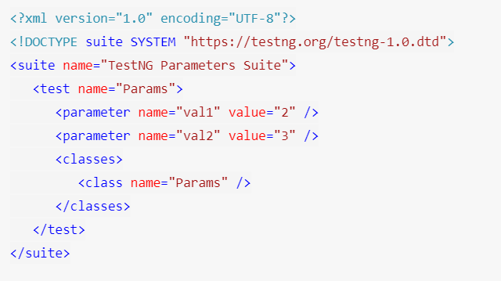
Contd
Note: TestNG Parameters are run through the TestNG XML file and not from the test case files directly.
Head over to the XML file and write the following XML code in it.

Slide 160
What are DataProviders in TestNG?
The DataProviders in TestNG are another way to pass the parameters in the test function.DataProviders pass different values to the TestNG Test Case in a single execution and in the form of TestNG Annotations.
DataProvider Syntax:
The TestNG DataProvider is used in the following manner:
@DataProvider (name = "name_of_dataprovider") public Object[][] dpMethod()
{
return new Object [][] { values}
}

Slide 161
Example
public class DP {
@DataProvider (name = "data-provider")
public Object[][] dpMethod()
{
return new Object[][] {{"First-Value"}, {"Second-Value"}};
}
@Test (dataProvider = "data-provider")
public void myTest (String val)
{
System.out.println("Passed Parameter Is : " + val);
}

Slide 162
Parallel Browser Testing
Parallel testing or parallel execution, as the name suggests, is a process of running the test case parallelly rather than one after the other. In parallel testing, the program's multiple parts (or modules) execute together, saving the testers a lot of time and effort.

Slide 163
Assertions
Assertions in TestNG are a way to verify that the expected result and the actual result matched or not. If we could decide the outcome on different small methods using assertions in our test case, we can determine whether our test failed or passed overall.
Syntax
Assert.assertEquals(actual, expected)
There are two types of TestNg Assert:
Hard Assert
Soft Assert

Slide 164
Commonly used TestNG Assert Methods
Assert.assertEqual(String actual, String expected): Pass the actual string value and the expected string value as parameters. Validates if the actual and expected values are the same or not.
Assert.assertEqual(String actual, String expected, String message): Similar to the previous method just that when the assertion fails, the message displays along with the exception thrown.
Assert.assertEquals(boolean actual, boolean expected): Takes two boolean values as input and validates if they are equal or not.
Assert.assertTrue(condition): This method asserts if the condition is true or not. If not, then the exception error is thrown.
Assert.assertTrue(condition, message): Similar to the previous method with an addition of message, which is shown on the console when the assertion fails along with the exception.
Assert.assertFalse(condition): This method asserts if the condition is false or not. If not, then it throws an exception error.
Assert.assertFalse(condition, message): Similar to the previous method but with an addition of a message string which is shown on the console when the assertion fails, i.e., the condition is true*.

Slide 165
Hard and Soft Assert in TestNG
Hard Asserts are those asserts that stop the test execution when an assert statement fails, and the subsequent assert statements are therefore not validated.
Soft Assert in TestNG
Soft asserts are just the opposite of hard asserts. In soft asserts, the subsequent assertions keep on running even though one assert validation fails, i.e., the test execution does not stop.

Slide 166
BDD Framework
BDD framework i.e. Behavior Driven Development is a software development approach that allows the tester/business analyst to create test cases in simple text language (English). The simple language used in the scenarios helps even non-technical team members to understand what is going on in the software project.
Test scenarios are written separately in a different file, named as Feature file.
Tests are written by focusing user stories and system behavior in a layman language.
Code is subject to be written differently in step definitions file i.e. Java, Python.

Slide 167
Cucumber – A BDD Framework Tool
Cucumber is a Behavior Driven Development (BDD) framework tool to write test cases.
Given – When – Then Approach
Given: Some given context (Preconditions).
When: Some Action is performed (Actions).
Then: Particular outcome/consequence after the above step (Results).

Slide 168
Maven
(532) Understanding of Maven Repositories || Build Automation Tool || DEVOPS || Maven Interview Question – YouTube
(532) # How to Create Maven project in Eclipse #automation #Maven project in Eclipse #selenium - YouTube

Slide 169
Feature
Sample Feature File – Feature files are written in Gherkin Language
Feature: BDD implementation using Cucumber Scenario: Login to G-mail using Cucumber plugin Given User is navigating to G-mail Login Page
When User need to enter username as "Username" and password as "Password“
Then User is successfully navigated to the G-mail Mail Box

Slide 170
Step Definitions
A Step Definition is a small piece of code with a pattern attached to it or in other words a Step Definition is a java method in a class with an annotation above it. An annotation followed by the pattern is used to link the Step Definition to all the matching Steps, and the code is what Cucumber will execute when it sees a Gherkin Step. Cucumber finds the Step Definition file with the help of the Glue code in Cucumber Options.

Slide 171
Cucumber Options
In layman language, @CucumberOptions are like property files or settings for your test. Basically @CucumberOptions enables us to do all the things that we could have done if we have used cucumber command line. This is very helpful and of utmost importance, if we are using IDE such eclipse only to execute our project.
Example:
@CucumberOptions( features = "Feature" ,glue={"stepDefinition"} ) public class TestRunner { }

Slide 172
Scenario Outline
In Gherkin language, scenario outline is the keyword which is used to run the same scenario multiple times.
It is also defined as "Scenario outlines are used when the same test is performed multiple times with a different combination of values.“
Scenario outline is exactly similar to the scenario structure, but the only difference is the provision of multiple inputs. In order to use scenario outlines, we do not need any smart idea, we just need to copy the same steps and re-execute the code.

Slide 173
Hooks
Hooks are blocks of code that run before or after each scenario in the Cucumber execution cycle. This allows us to manage the code workflow better and helps to reduce code redundancy.
Hooks can be defined anywhere in the project or step definition layers using the methods @Before and @After.
@Before - Before hooks run before the first step of each scenario. This is commonly used for prerequisite steps that need to be performed before the actual test scenario. For example, this can be as follows.
@After - After hooks run after the last step of each scenario, even when steps are failed, undefined, pending, or skipped. This is commonly used for steps that need to be performed after the actual scenario gets executed.

Slide 174
Pretty Report
The first plugin, we will talk about is Pretty. This provides more verbose output. To implement this, just specify plugin = "pretty" in CucumberOptions. This is what the code looks like:
@CucumberOptions( plugin = { "pretty" } )

Slide 175
HTML Report
For HTML reports, add html:target/cucumber-reports to the @CucumberOptions plugin option.
Note: We have specified the path of the Cucumber report, which we want it to generate it under the target folder.
This will generate an HTML report at the location mentioned

Slide 176
HTML Report using extent report
Let’s check out how we can generate the extent report for Cucumber.
1) In POM.Xml please add below maven dependencies.
<dependency><groupId>com.aventstack</groupId><artifactId>extentreports</artifactId><version>3.0.6</version></dependency> <dependency><groupId>com.vimalselvam</groupId><artifactId>cucumber-extentsreport</artifactId><version>3.0.2</version></dependency>
Add extent-config.xml file under test/resources in your maven project.
In the Runner File under plugin please add below code
Plugin={“com.cucumber.listener.ExtentCucumberFormatter:target/html/ExtentReport.html “}

Slide 177
Capturing ScreenShot in Selenium
To take a screenshot in Selenium, we use an interface called TakesScreenshot, which enables the Selenium WebDriver to capture a screenshot and store it in different ways. It has a got a method "getScreenshotAs() " which captures the screenshot and store it in the specified location.
Below is a fundamental syntax of capturing a screenshot, using Selenium WebDriver, of the currently visible part of the Web page:
//Convert webdriver to TakeScreenshot File screenshotFile = ((TakesScreenshot) driver).getScreenshotAs(OutputType.FILE);

Slide 178
Version Control System
Version Control System (VCS) is a software that helps software developers to work together and maintain a complete history of their work.
Listed below are the functions of a VCS −
Allows developers to work simultaneously.
Does not allow overwriting each other’s changes.
Maintains a history of every version.
Git
It is a free and open-source version control system used to handle small to very large projects efficiently. Git is used to tracking changes in the source code, enabling multiple developers to work together

Slide 179
How to download Git?
Step1
To download the Git installer, visit the Git's official site and go to download page. The link for the download page is https://git-scm.com/downloads.
Click on the package given on the page as download 2.35.3 for windows. The download will start after selecting the package.
Now, the Git installer package has been downloaded.
Step2
Click on the downloaded installer file and select yes to continue.
Step3
Default components are automatically selected in this step. You can also choose your required part.
Step4
The default Git command-line options are selected automatically. You can choose your preferred choice. Click next to continue.
Step5
The default transport backend options are selected in this step. Click next to continue.
Step6
Select your required line ending option and click next to continue.
Step7
Select preferred terminal emulator clicks on the next to continue.
Therefore, The Git installation is completed. Now you can access the Git Gui and Git Bash.

Slide 180
GitHub
GitHub is a Git repository hosting service. GitHub also facilitates with many of its features, such as access control and collaboration. It provides a Web-based graphical interface.
Navigate to https://github.com/login
Create an account in github and login
Step 1: Create a new git repository
Step 2: Add a new file to the repo
Step3: clone the repository into local machine
Step4: Add new files to the local repository
Step5: Commit the code
Step6: Push the code to remote repository
Step7: pull the changes to local repository

Slide 181
Git commands
git init
The command git init is used to create an empty Git repository.
After the git init command is used, a .git folder is created in the directory with some subdirectories. Once the repository is initialized, the process of creating other files begins.
git clone <repository url>
The git clone command is used to create a local working copy of an existing remote repository.
The command downloads the remote repository to the computer. It is equivalent to the Git init command when working with a remote repository.
git add .
Add command is used after checking the status of the files, to add those files to the staging area.
Before running the commit command, "git add" is used to add any new or modified files.
git commit
The commit command makes sure that the changes are saved to the local repository.
The command "git commit –m <message>" allows you to describe everyone and help them understand what has happened.
git commit -m “commit message”

Slide 182
Contd..
git status
The git status command tells the current state of the repository.
git config
The git config command is used initially to configure the user.name and user.email. This specifies what email id and username will be used from a local repository.
When git config is used with --global flag, it writes the settings to all repositories on the computer.
git config --global user.name “any user name”
git config --global user.email <email id>

Slide 183
Contd..
git branch
The git branch command is used to determine what branch the local repository is on.
The command enables adding and deleting a branch.
# Create a new branch git branch <branch_name>
# List all remote or local branches git branch -a
# Delete a branch git branch -d <branch_name>
git checkout
The git checkout command is used to switch branches, whenever the work is to be started on a different branch.
The command works on three separate entities: files, commits, and branches.
# Checkout an existing branch git checkout <branch_name>

Slide 184
Contd..
git push
The command git push is used to transfer the commits or pushing the content from the local repository to the remote repository.
The command is used after a local repository has been modified, and the modifications are to be shared with the remote team members.
git push -u origin master
git pull
The git pull command is used to fetch and merge changes from the remote repository to the local repository.
The command "git pull origin master" copies all the files from the master branch of the remote repository to the local repository.
git pull <branch_name> <remote URL>
git log
The git log command shows the order of the commit history for a repository.
The command helps in understanding the state of the current branch by showing the commits that lead to this state.
git log

Slide 185
CI/CD
In Continuous Integration after a code commit, the software is built and tested immediately. In a large project with many developers, commits are made many times during a day. With each commit code is built and tested. If the test is passed, build is tested for deployment. If the deployment is a success, the code is pushed to Production. This commit, build, test, and deploy is a continuous process, and hence the name continuous integration/deployment.
What is Continuous Delivery (CD)?
Continuous Delivery is a software engineering method in which a team develops software products in a short cycle. It ensures that software can be easily released at any time. The main aim of continuous delivery is to build, test, and release software with good speed and frequency. It helps you to reduce the cost, time, and risk of delivering changes by allowing for frequent updates in production.

Slide 186
Jenkins
Jenkins is an open-source Continuous Integration server written in Java for orchestrating a chain of actions to achieve the Continuous Integration process in an automated fashion. Jenkins supports the complete development life cycle of software from building, testing, documenting the software, deploying, and other stages of the software development life cycle.
Jenkins is a widely used application around the world that has around 300k installations and growing day by day. By using Jenkins, software companies can accelerate their software development process, as Jenkins can automate build and test at a rapid rate.

Slide 187
How to Download & Install Jenkins on Windows
Prerequisites:
Before you proceed to install Jenkins in your windows system, there are some prerequisites for Jenkins to install Jenkins in your computer.
Hardware requirements:
You need minimum 256 MB of RAM in your computer or laptop to install Jenkins
You need at least 1 GB of space in your hard drive for Jenkins.
Software Requirements:
Since Jenkins runs on Java, you need either older version of Java Development Kit (JDK) or Java Runtime Environment (JRE).

Slide 188
How to Download Jenkins?
Following steps should be followed so that to install Jenkins successfully:
Step 1) Got to https://www.jenkins.io/download/ and select the platform.
Step 2) Go to download location from local computer and unzip the downloaded package. Double-click on unzipped jenkins.msi.
Step 3) In the Jenkin Setup screen, click Next.
Step 4) Choose the location where you want to have the Jenkins instance installed (default location is C:\Program Files (x86)\Jenkins), then click on Next button.
Step 5)Click on the Install button.
Step 6) Once install is complete, click Finish.

Slide 189
How to Unblock Jenkins?
Step 1) After completing the Jenkins installation process, a browser tab will pop-up asking for the initial Administrator password. To access Jenkins, you need to go to browse the following path in your web browser. http://localhost:8080
If you can access the above URL, then it confirms that Jenkins is successfully installed in your system.
To start the jenkins service
java –jar jenkins.war

Slide 190
Step 2) The initial Administrator password should be found under the Jenkins installation path (set at Step 4 in Jenkins Installation).
For default installation location to C:\Program Files (x86)\Jenkins, a file called initialAdminPassword can be found under C:\Program Files (x86)\Jenkins\secrets.
However, If a custom path for Jenkins installation was selected, then you should check that location for initialAdminPassword file.
Step 3) Open the highlighted file and copy the content of the initialAdminPassword file.
Step 4) Paste the password it into browser’s pop-up tab (http://localhost:8080/login?form=%2F) and click on Continue button.

Slide 191
Cron Job Examples
Start build daily at 08:30 in the morning, Monday - Friday: 30 08 * * 1-5
Weekday daily build twice a day, at lunchtime 12:00 and midnight 00:00, Sunday to Thursday: 00 0,12 * * 0-4
Start build daily in the late afternoon between 4:00 p.m. - 4:59 p.m. or 16:00 -16:59 depending on the projects hash: H 16 * * 1-5
Start build at midnight: @midnight or start build at midnight, every Saturday: 59 23 * * 6
Every first of every month between 2:00 a.m. - 02:30 a.m.: H(0,30) 02 01 * *
Every 5 minutes */5 * * * *

